Slide 1
PREDICTING CUSTOMER CHURN IN TELECOM INDUSTRY

Slide 2
Team Members And Roles
Rithwik - Dataset Exploration and Pre-processing
Vamshi - Model Development
Tulasi - Model Development
Sruthi - Model Evaluation
Achyuth - Deployment and Pre-processing

Slide 3
Nature of Data
The sample Size of the data is about 7000+ customer records
The features including about 20+ demographics, account details and their services.
The target variable is the Churn.
Coming to the Initial observations Tenure, Monthly charges, Total Charges, and the quality check

Slide 4
Dataset Loading
Initializing the Spark session and loading the dataset.
Examination of the dataset to understand its contents and structure.
Checking for the outliers if any.
Identification of missing values in the dataset to assess data quality.
Dividing the columns into numerical and categorical.
Analysis of basic statistics such as averages and ranges for numerical attributes.
Distribution of the target variable (Churn) and understanding the churn.

Slide 5
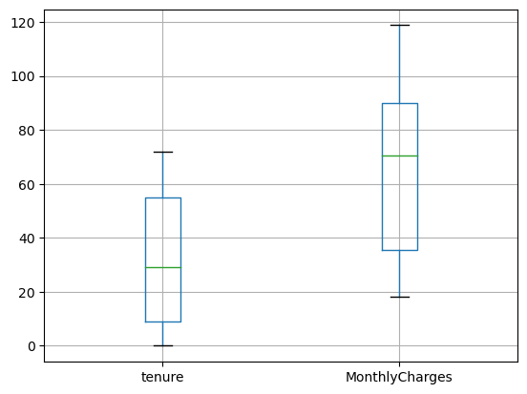
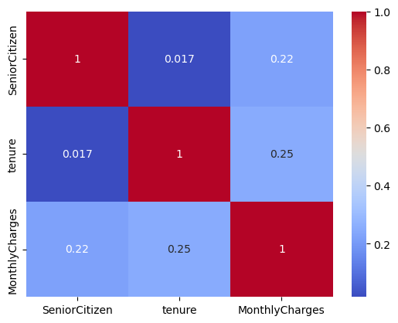
Box plot and Heat map

Slide 6
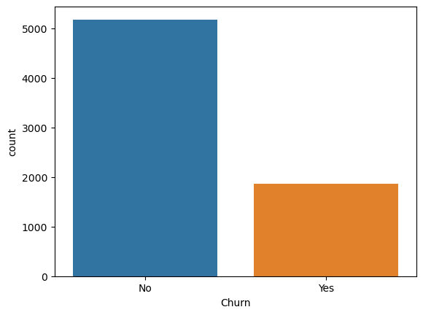
Exploratory Data Analysis
Target Variable

Slide 7
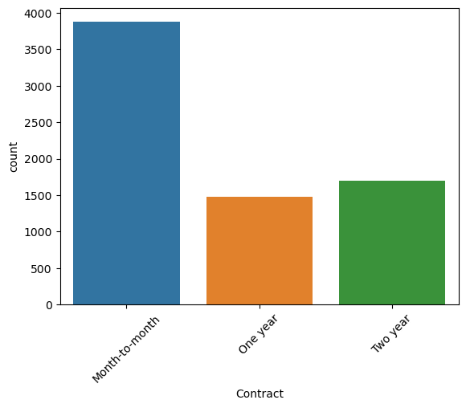
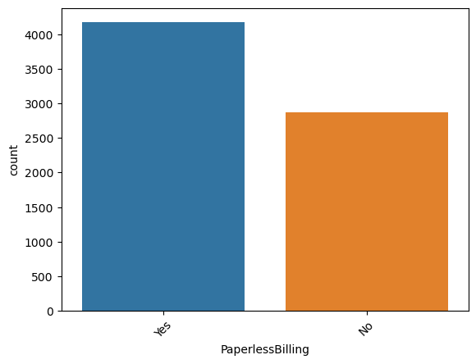
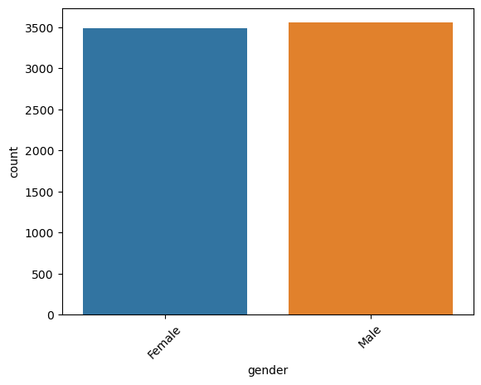
Graphs for Features Visualization
Contract
Paperless billing
Gender

Slide 8
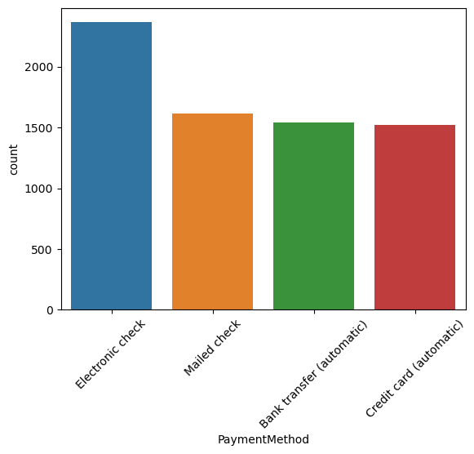
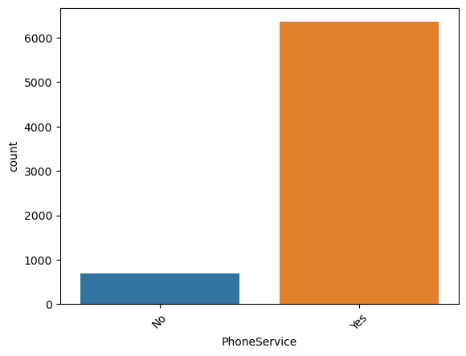
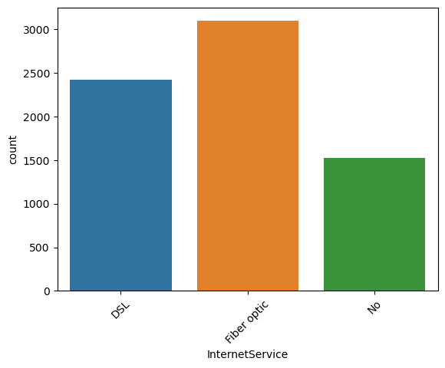
Graphs for Features Visualization
Payment Method
Phone service
Internet Service

Slide 9

Data Pre-processing
Missing Values
Categorical data to numerical data
Normalization
Feature selection
Data split into train and test sets

Slide 10
Model Development
Training model on random forest
Hyperparameter tuning using grid search CV

Slide 11
Model Evaluation
Accuracy
Precision
Recall
F1-score
ROC-AUC

Slide 12
Deployment and Interpretability
We select the random forest classifier with the best parameter after performing hyperparameter tuning.
We are going to deploy the model in the AWS
We test the deployment environment with new random samples.

Slide 13

Thank You

